Slide 1
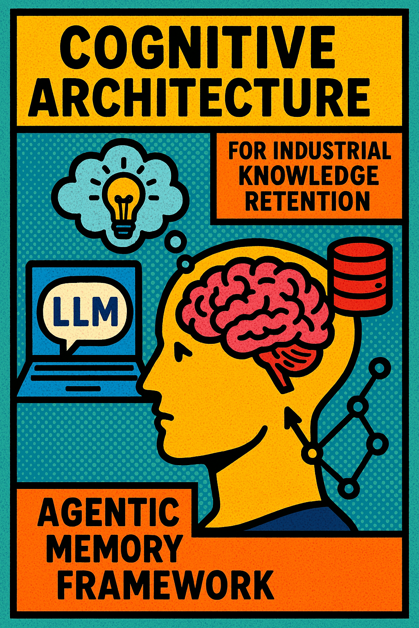
Cognitive Architecture for Industrial Knowledge Retention:
An LLM-Based Agentic Memory Framework
Sarah Eschenbacher, BSc
This thesis presents an AI system designed to address industrial skill shortages through the integration of knowledge from both written documentation and experienced workers' expertise. The system employs four distinct memory types, inspired by human memory, to effectively capture, store, and facilitate knowledge exchange between humans and AI assistants.
own illustration

